Slide 1
Open SUT Overview (SysML v1)
Presented by Galois

Slide 2
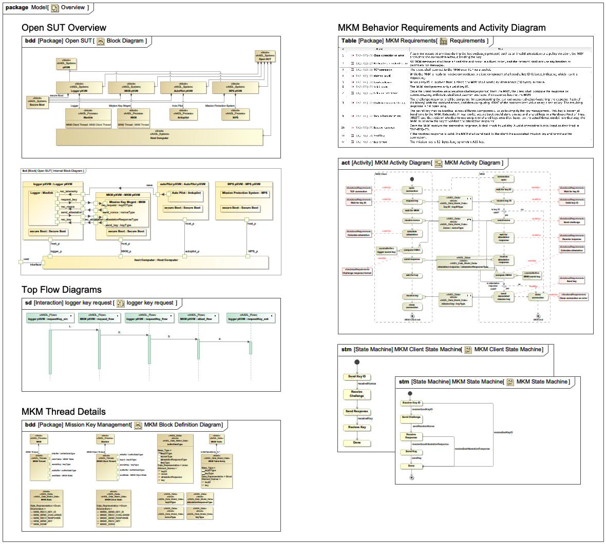
Overview

Slide 3
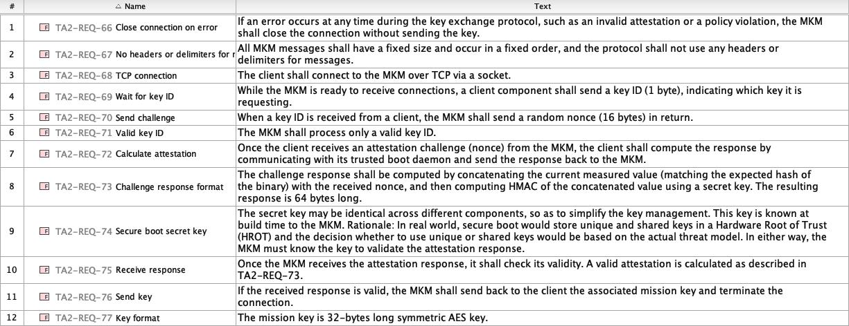
Requirements

Slide 4
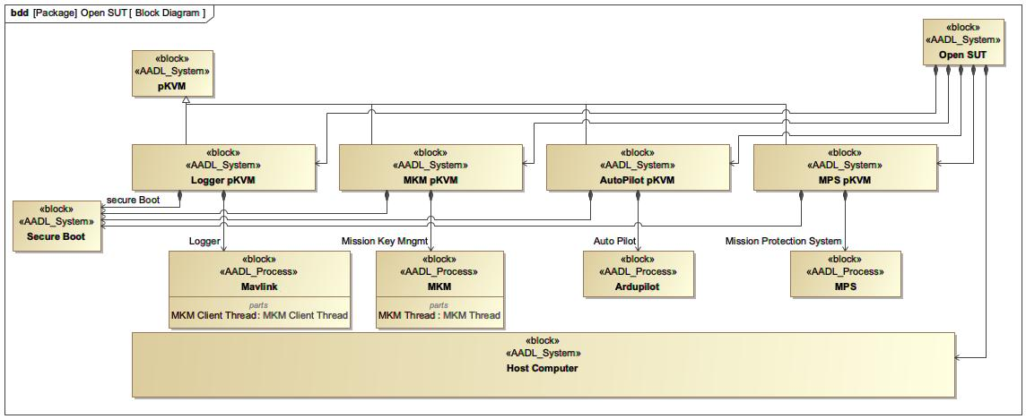
Block Diagram

Slide 5
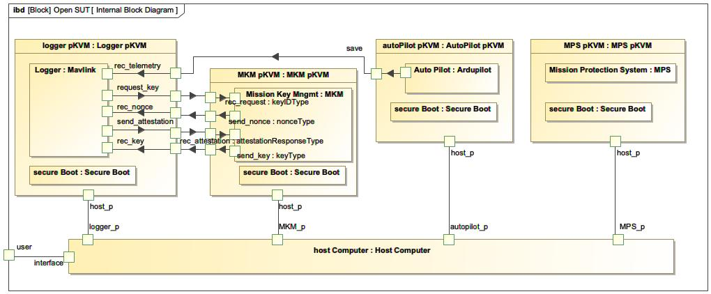
Internal Block Diagram

Slide 6
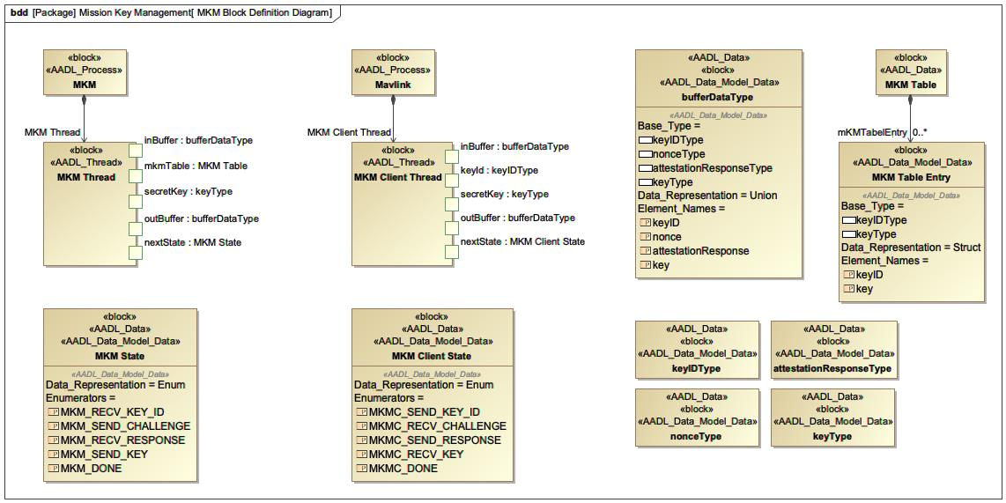
MKM Block Definition Diagram

Slide 7
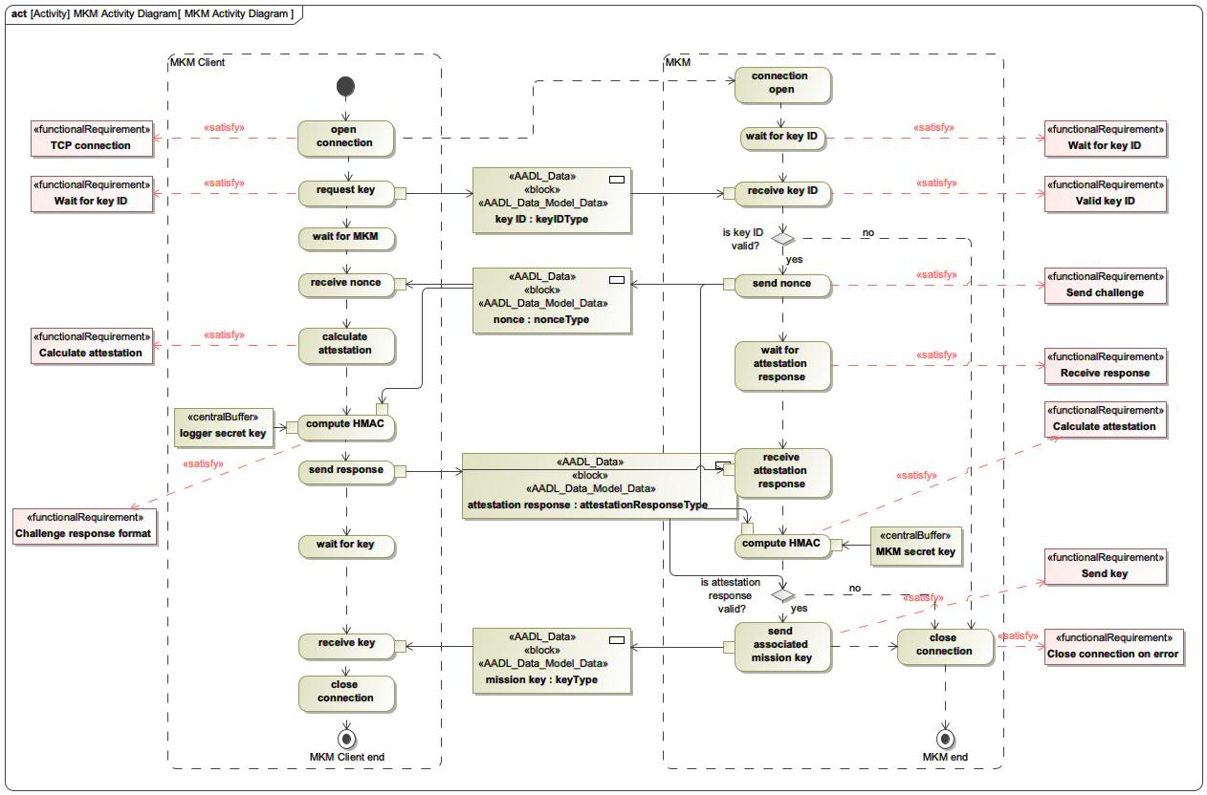
MKM Activity Diagram

Slide 8
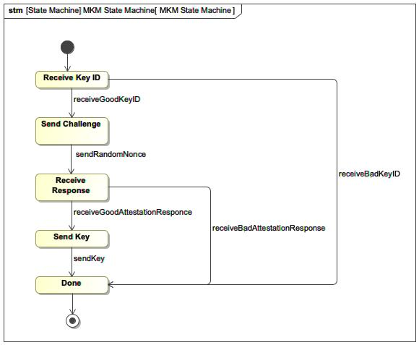
MKM State Machine

Slide 9
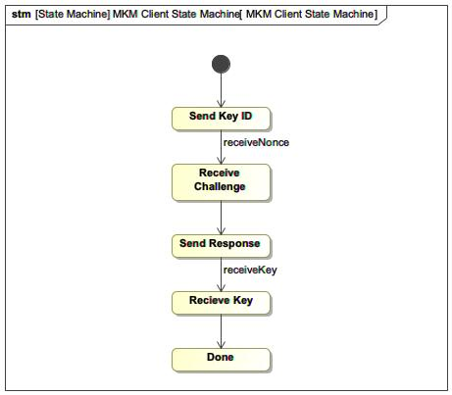
MKM Client State Machine

Slide 10
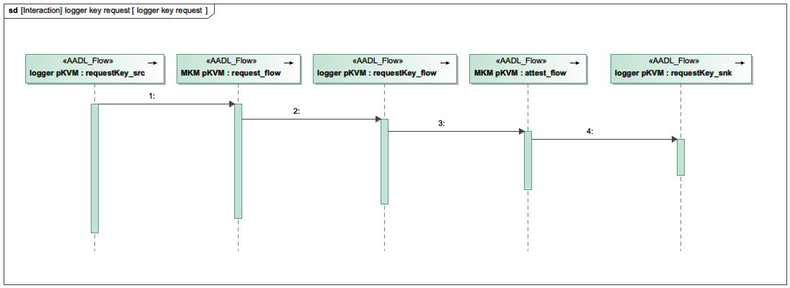
logger key request

Slide 11
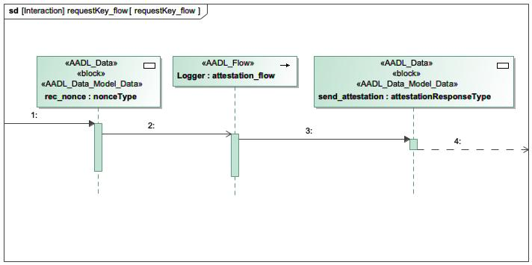
requestKey_flow

Slide 12
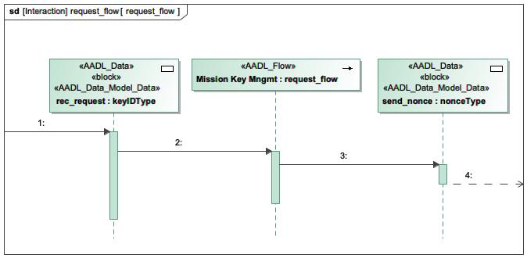
request_flow

Slide 13
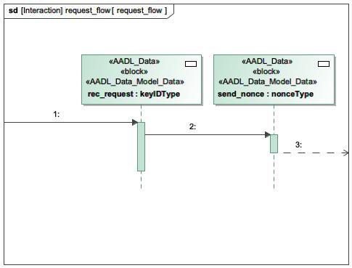
request_flow

Slide 14
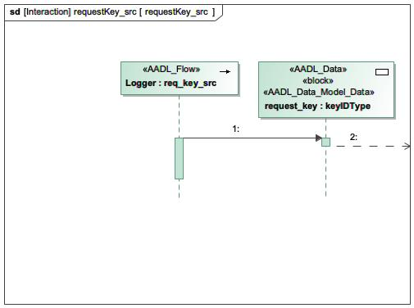
requestKey_src

Slide 15
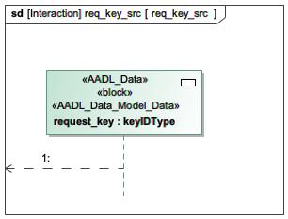
req_key_src

Slide 16
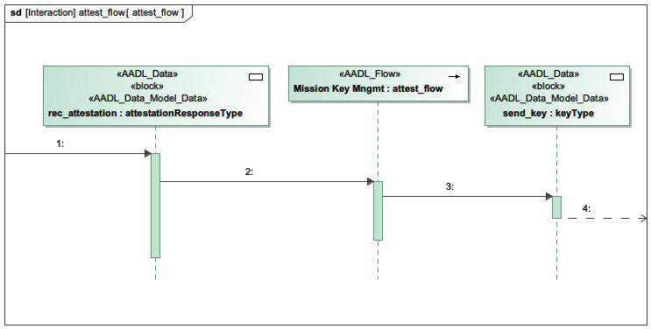
attest_flow

Slide 17
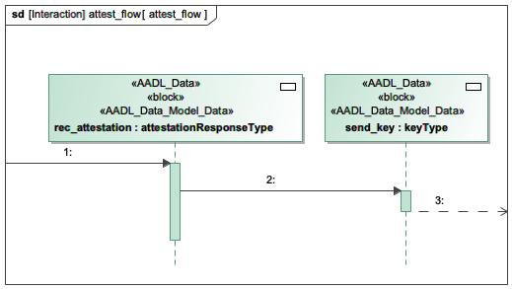
attest_flow

Slide 18
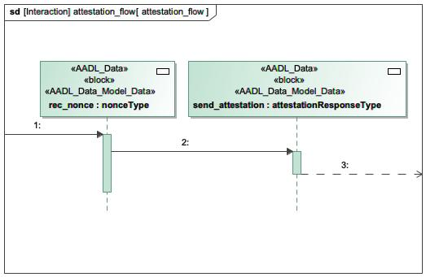
attestation_flow

Slide 19
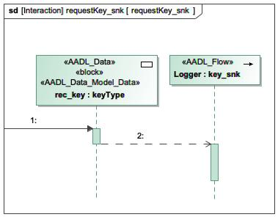
requestKey_snk

Slide 20
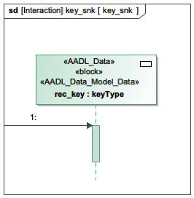
key_snk

Slide 21
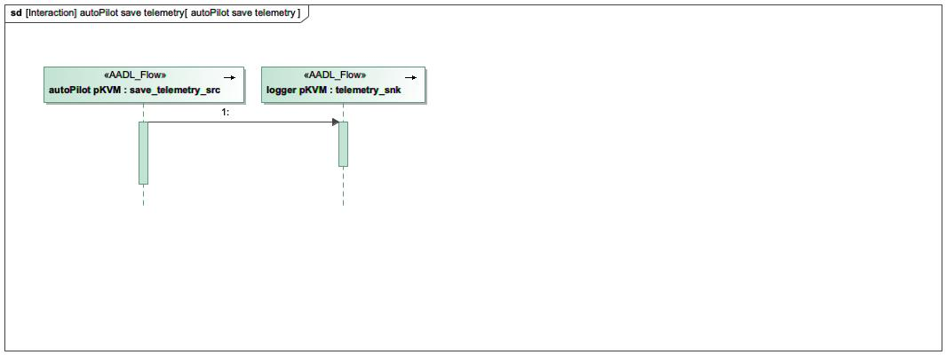
autoPilot save telemetry

Slide 22
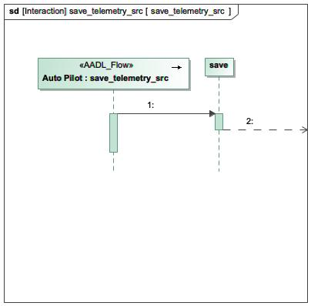
save_telemetry_src

Slide 23
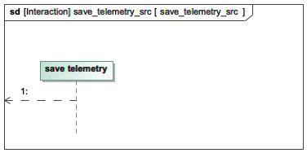
save_telemetry_src

Slide 24
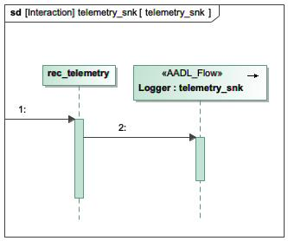
telemetry_snk

Slide 25
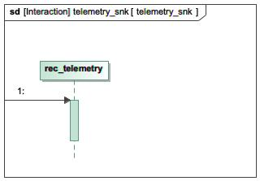
telemetry_snk

Slide 26
Open SUT Overview (AADL)
Presented by Galois

Slide 27
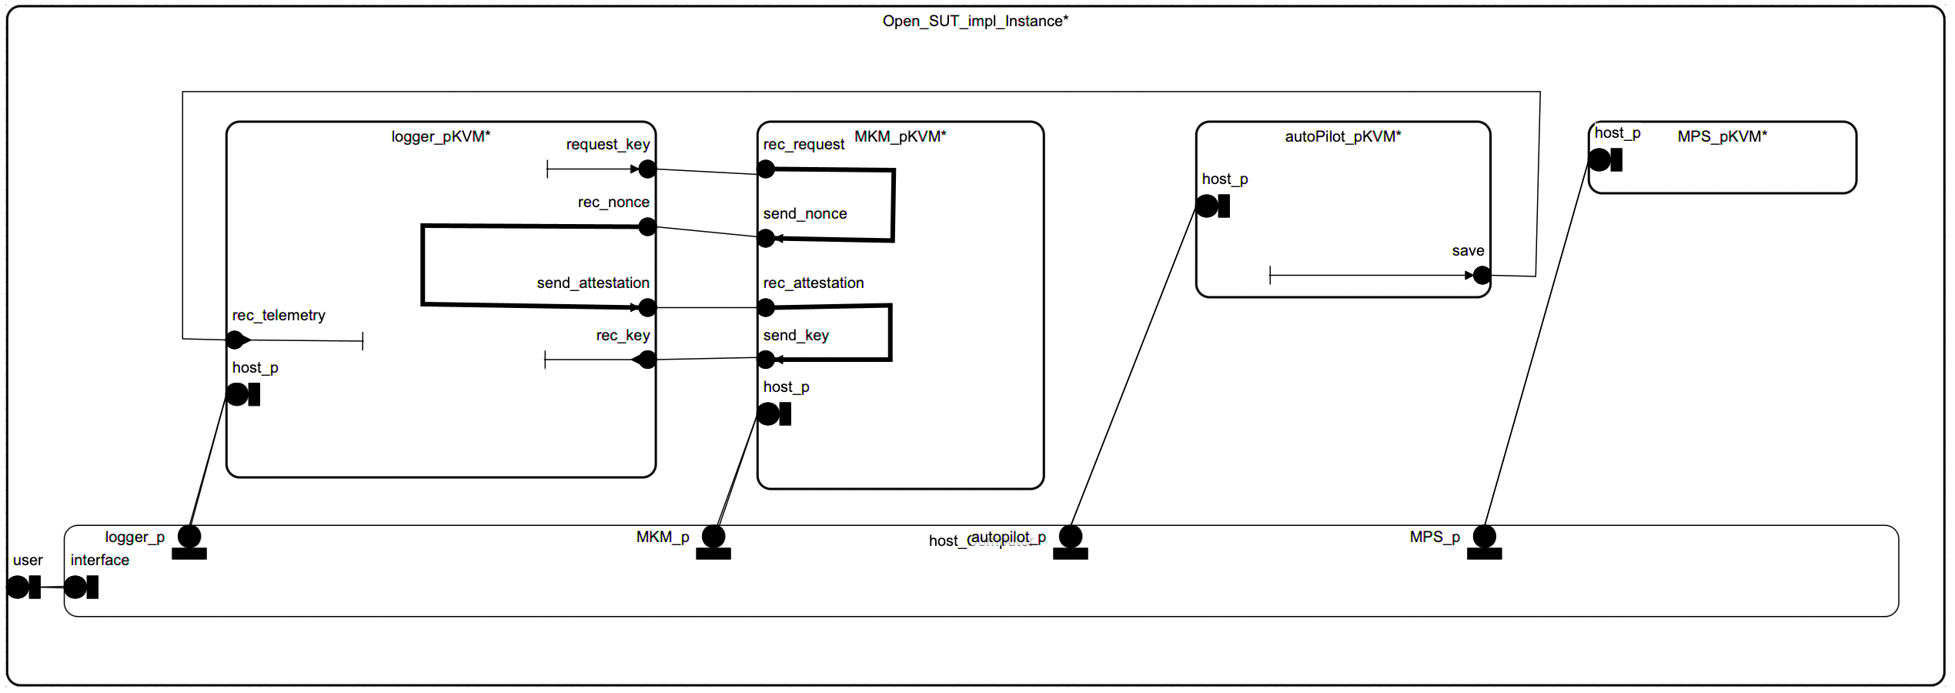
Generated AADL

Slide 28
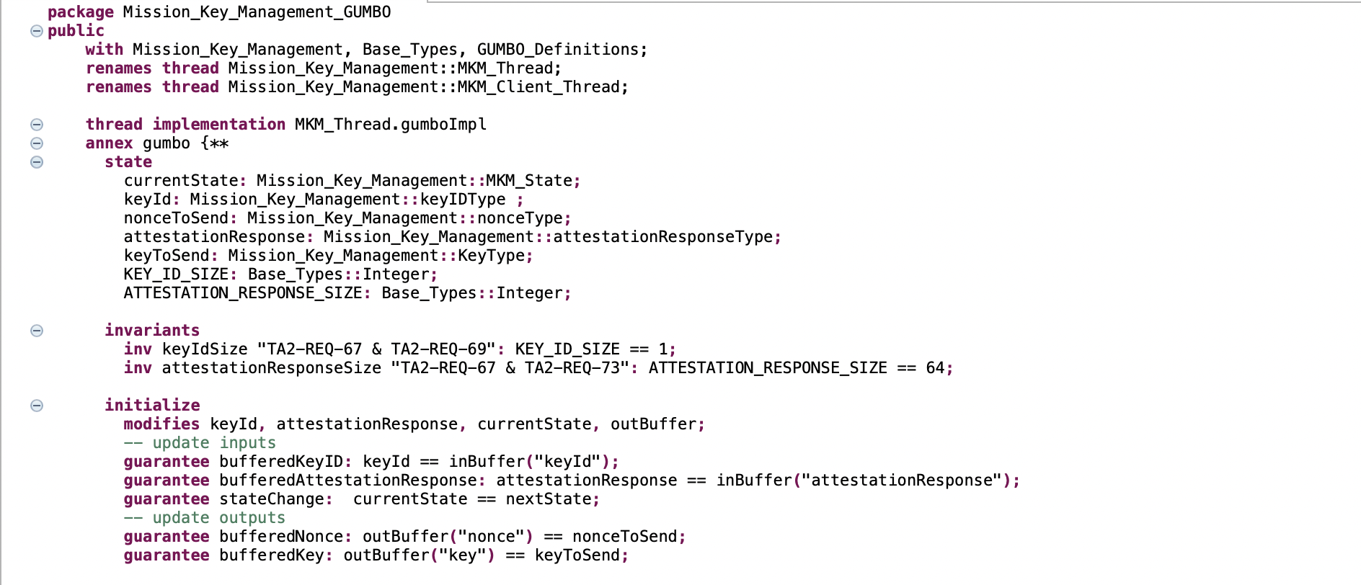
MKM AADL GUMBO Part 1/3

Slide 29
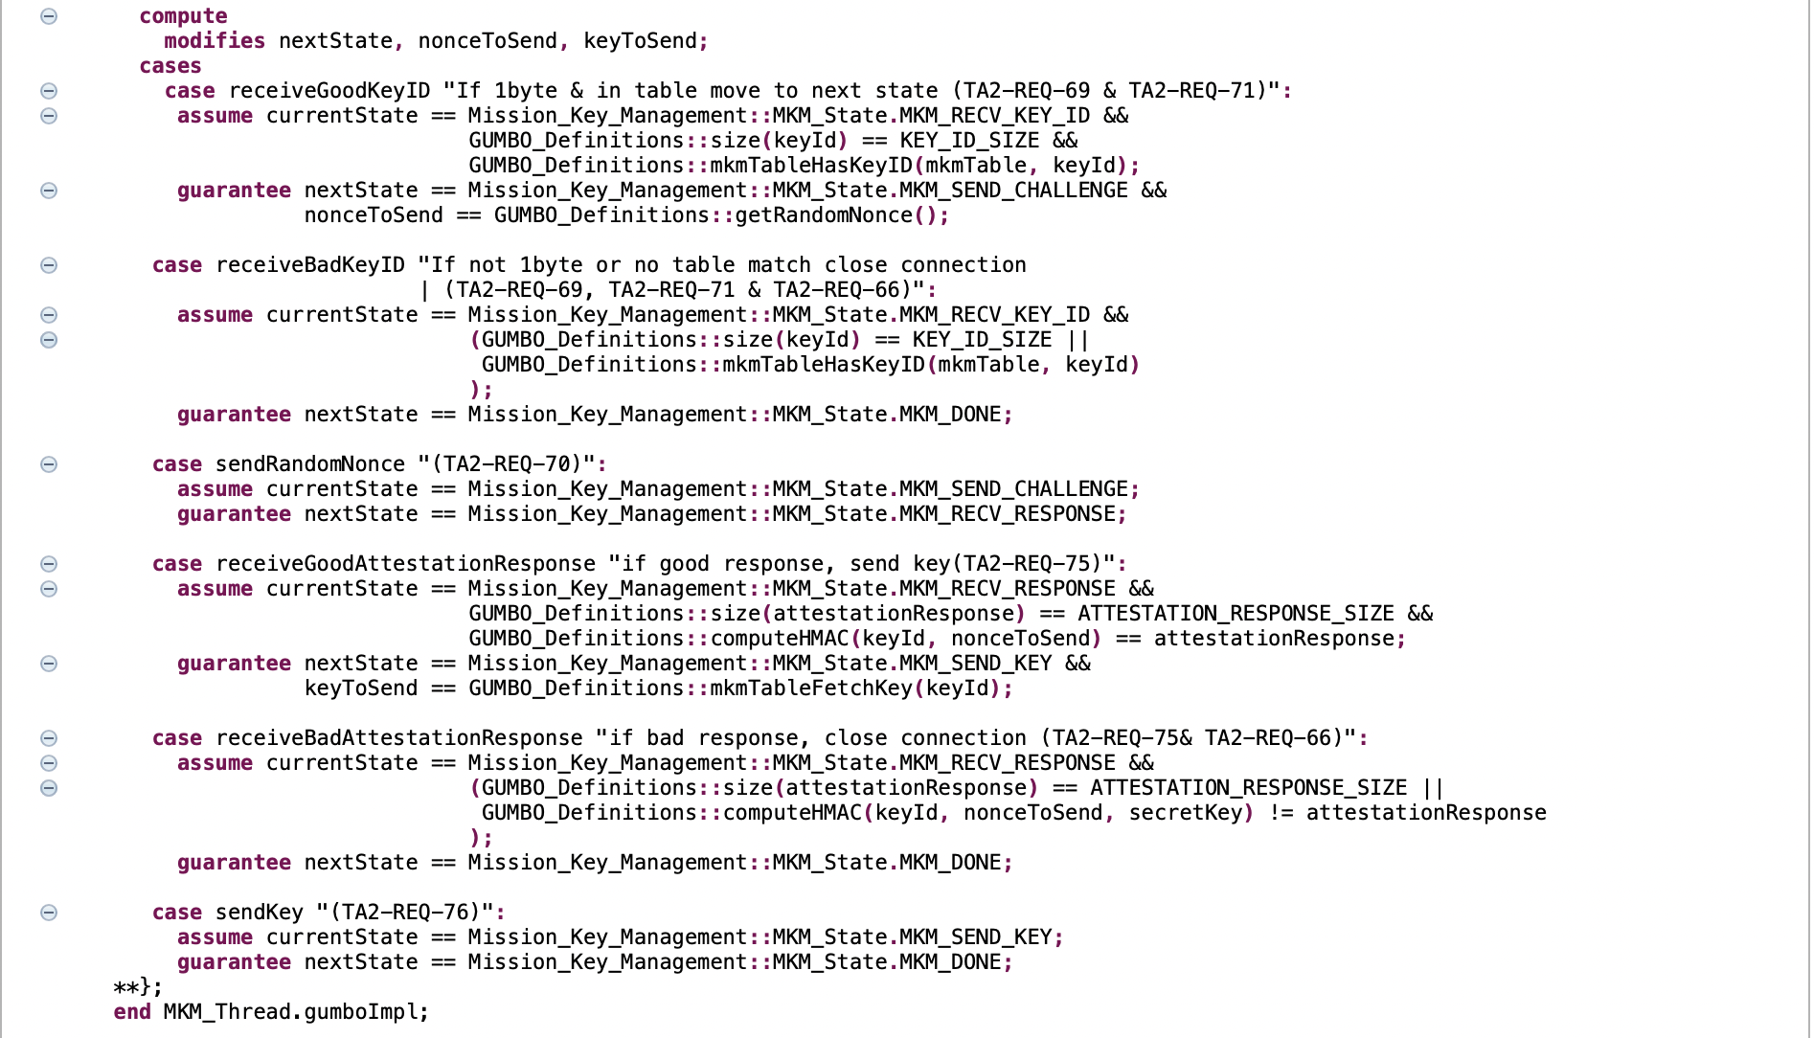
MKM AADL GUMBO Part 2/3

Slide 30
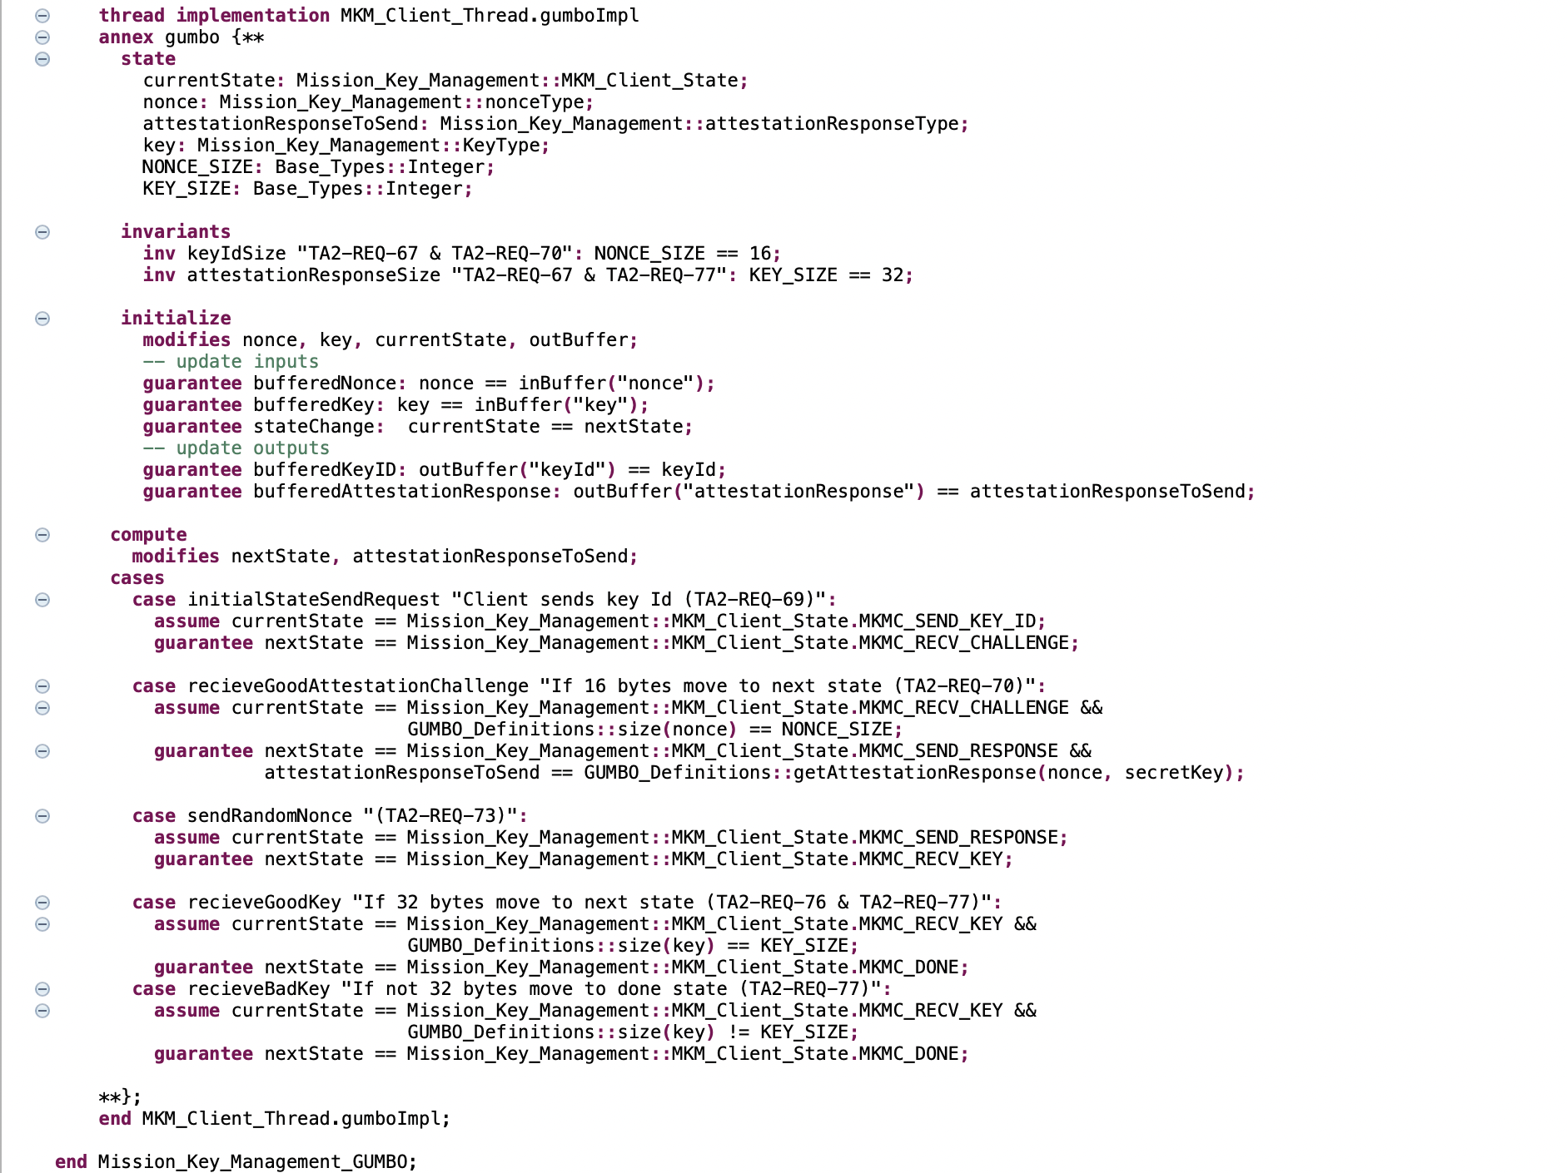
MKM AADL GUMBO Part 3/3

